Slide 1
Implier – Architecture
Ben Lackey

Slide 2
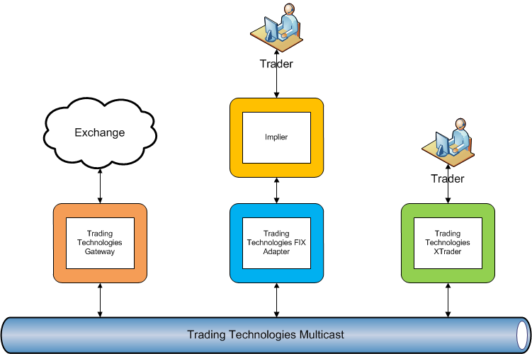
Trading Technologies Architecture for Phase 1

Slide 3
Trading Technologies Architecture for Phase 1
This solution leverages the TT components.
Allowing fast development time
Use Schneider’s existing risk infrastructure
Latency is going to be high in this scenario
Costs
Computer to run XTrader, FIX Adapter and Implier
Use a virtual machine at Schneider initially
no cost
Move to physical kit later in phase 1
cost associated with this
Xtrader – £1300/month
FIX Adapter – £1300/month

Slide 4
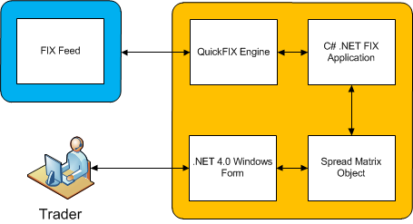
Phase 1 Implier
FIX Connection to TT
QuickFIX Engine
http://quickfix.org/
C# .NET 4.0
Significantly faster than Excel and Visual Basic
Windows Presentation Foundation
Next generation windowing toolkit

Slide 5
Ben – Next Steps
Get both Ben and QuatumSoft access to Trading Technologies development environment with live data
Get Ben access to Schneider environment with live data
Verify algorithm is implemented correctly

Slide 6
QuantumSoft – Next Steps
Be able to bring main window in front of other windows.
Open multiple spread matrix / pure arbitrage windows
May incur a negative performance impact which will be optimized in phase 2
Update pure arbitrage window automatically
Add fix order session to config files
Ben added them, but something isn't working in the application
Add buy button to pure arbitrage window
implement process defined in slides 7 and 8 to submit the orders
Eliminate the dependency between the spread matrix and pure arbitrage windows, so the spread matrix does not need to be open in order for a pure arbitrage window to be

Slide 7
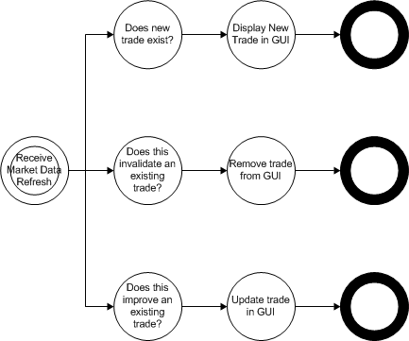
Market Data Refresh State Diagram
These operations need to be performed atomically

Slide 8
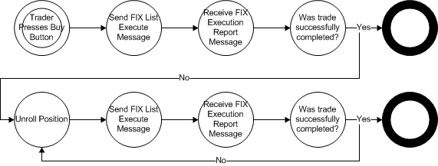
Market Data Refresh State Diagram
In Phase 1 we will replace the buy button with “go” and “stop” buttons
Either later in phase 1 or preferably in a later phase we are going to attempt to repair the trade (buy any missing legs) rather than simply unrolling the trade

Slide 9
To Complete Phase 1
We need to automate the Implier application.
First, run with a “buy” button
Then perhaps remove the buy button and replace that with a "buy one and then stop button."
Assuming that works, then replace that with "go" and "stop" buttons.
If all that works and the connectivity is ok (which is Ben’s responsibility), then we should be at the point to start phase 2.

Slide 10
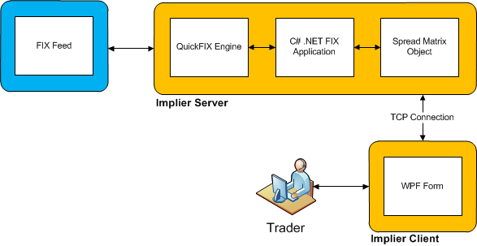
Phase 2 Implier
Decouple Implier server and client components
Allows the Implier server to run independently of the client interface
This reduces latency for the pure arbitrage scenario
Multiple clients could be supported by a single server

Slide 11
Phase 2 Implier
Increase outsourcing to Ben’s Russian contacts
http://quantumsoft.ru/
Hire two fulltime QuantumSoft developers
2 x £1800-2000/month for expert level developers
Optimize algorithm
Consider implementing algorithm in C or assembly
Optimize support for multiple symbols
Enhanced support for multiple processors

Slide 12
Phase 3+ Implier
Consider rewriting the engine component in F# to take advantage of multicore processors
http://msdn.microsoft.com/en-us/fsharp/default.aspx
Would allow use of .NET C# QuickFIX API
Consider using Microsoft AppFabric to share spread matrix state across multiple GUIs
http://msdn.microsoft.com/en-gb/windowsserver/ee695849.aspx
Consider alternative FIX engines

Slide 13
Alternative Uses of the Implier
The slides above discuss how the Implier will be developed and then enhanced for pure arbitrage
Trades can be improved through the introduction of direct market access (DMA)
There are also alternative use cases that we will pursue
Execution Management System
Discretionary Trading System

Slide 14
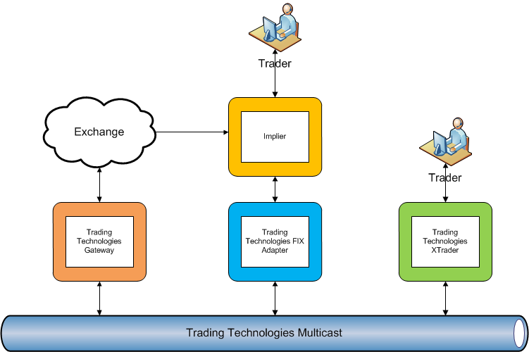
Trading Technologies Architecture with Direct Market Access (DMA)

Slide 15
Trading Technologies Architecture with Direct Market Access (DMA)
Access price data directly from the market
This bypasses the TT gateway, TT multicast and the TT FIX Adapter
Significant reduction in latency – likely on the order of 10-100ms
Execution
Continue to use TT infrastructure for trade execution
This means Schneider’s existing risk system will process all trades.

Slide 16
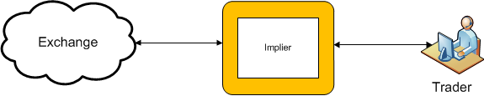
Direct Market Access (DMA)
Massive reduction in latency over the solutions presented earlier
Access via
Leased line
Hosted at Schneider
http://www.options-it.com/
Collocation in exchange

Slide 17
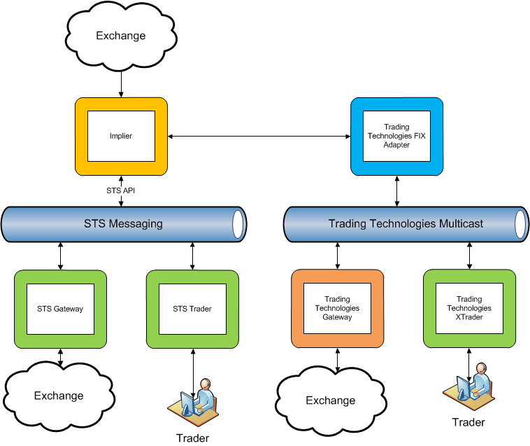
Implier as an Execution Management System (EMS)

Slide 18
Implier as an Execution Management System (EMS)
The Implier could also be used to generate prices for synthetic instruments
For example
WTI might be offered at 100
However, the Implier finds a 5 leg trade that gives WTI at 80
A trader would be presented with a synthetic version of WTI that gives the best price, in this case the 5 leg trade.
This would happen seamlessly. From a trader’s perspective they would be trading the same instrument only seeing better prices than the market at large.

Slide 19
Implier as a Discretionary Trading System

